Slide 1

YZY Language School
Ying HAO
Yaowu HUANG
Zhiwei LI
APR 19, 2021

Slide 2

Agenda
Technologies and Challenges
Database Design
Mockup

Slide 3
Technologies - MVVM Architecture - C# / WPF - Entity Framework - RDBMS - 2D drawing (chart) - Globalization / Localization - Unit Test Challenges - MVVM Architecture - Multiple Validations (XAML, view model, model, database) - UI Design (Responsive, Tab, Animation Effect, User Control) - Drawing pie chart / bar chart - String Translation - Database Migration (Local to Azure) - Publish Install Packages

Slide 4

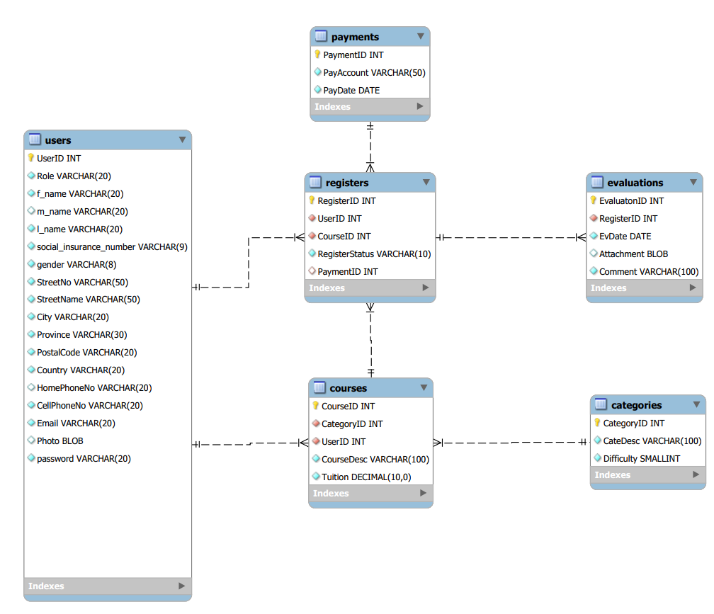
Database Migration

Slide 5
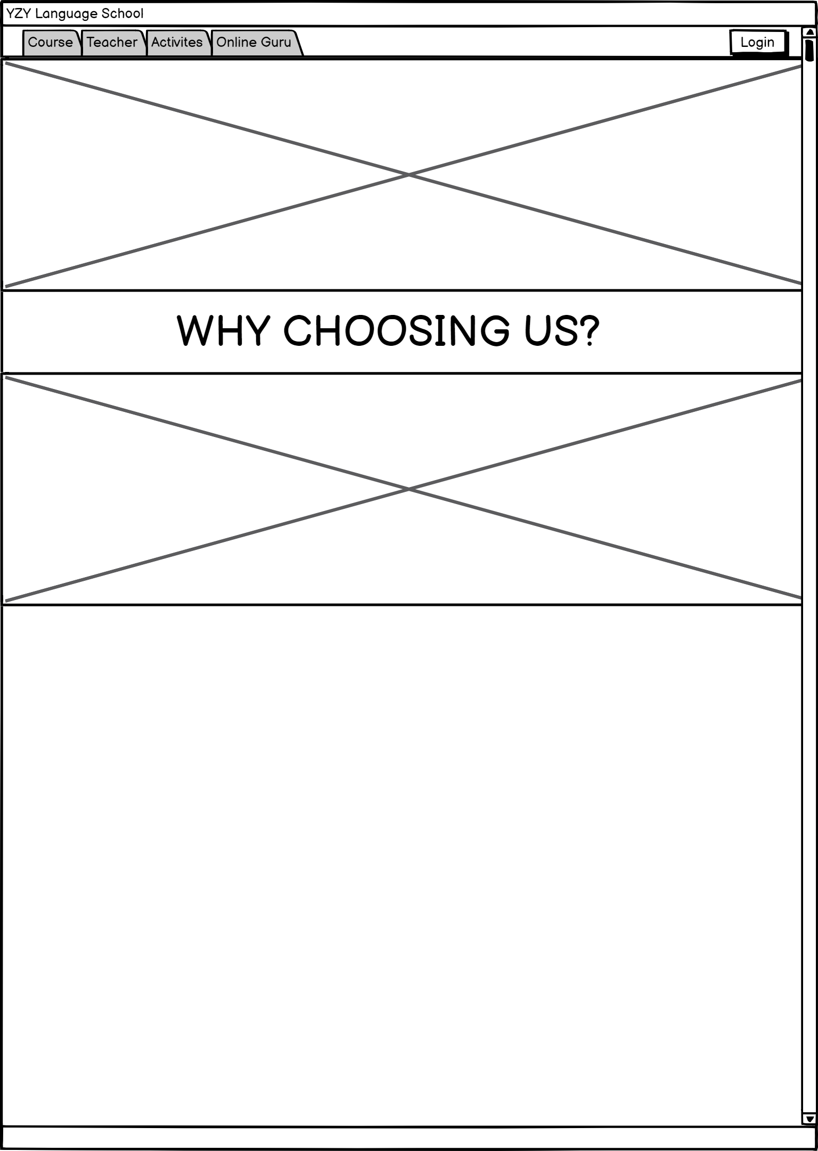

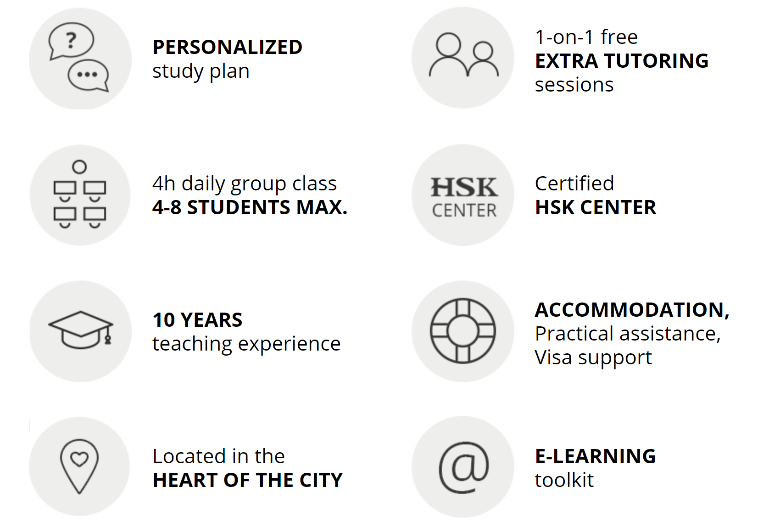

User Interface

